Slide 1
POL 103
Tuesday
August 31
Introduction and Overview
Hi!
Course Mechanics
The insurrection
Models
A first puzzle about governments

Slide 2
Introduction and Overview
Hi!
Course Mechanics
The insurrection
Models
A first puzzle about governments

Slide 3
Introduction and Overview
Ian Hopper - dhopper@marymount.edu
(It’s David)
Foreign Service Officer, State Dept
Deputy Director, Iraq Desk
...but Iraq is ممنوع
Baghdad, Frankfurt, Amman, Chennai, Lome, Manila - Mainly Consular
I speak French (badly), and Arabic (worse)
Marymount University ‘96 (+ family)

Slide 4
Introduction and Overview
Hi!
Course Mechanics / Syllabus
The insurrection
Models
A first puzzle about governments

Slide 5
Introduction and Overview
Hi!
Course Mechanics / Syllabus
The insurrection
Models
A first puzzle about governments

Slide 6
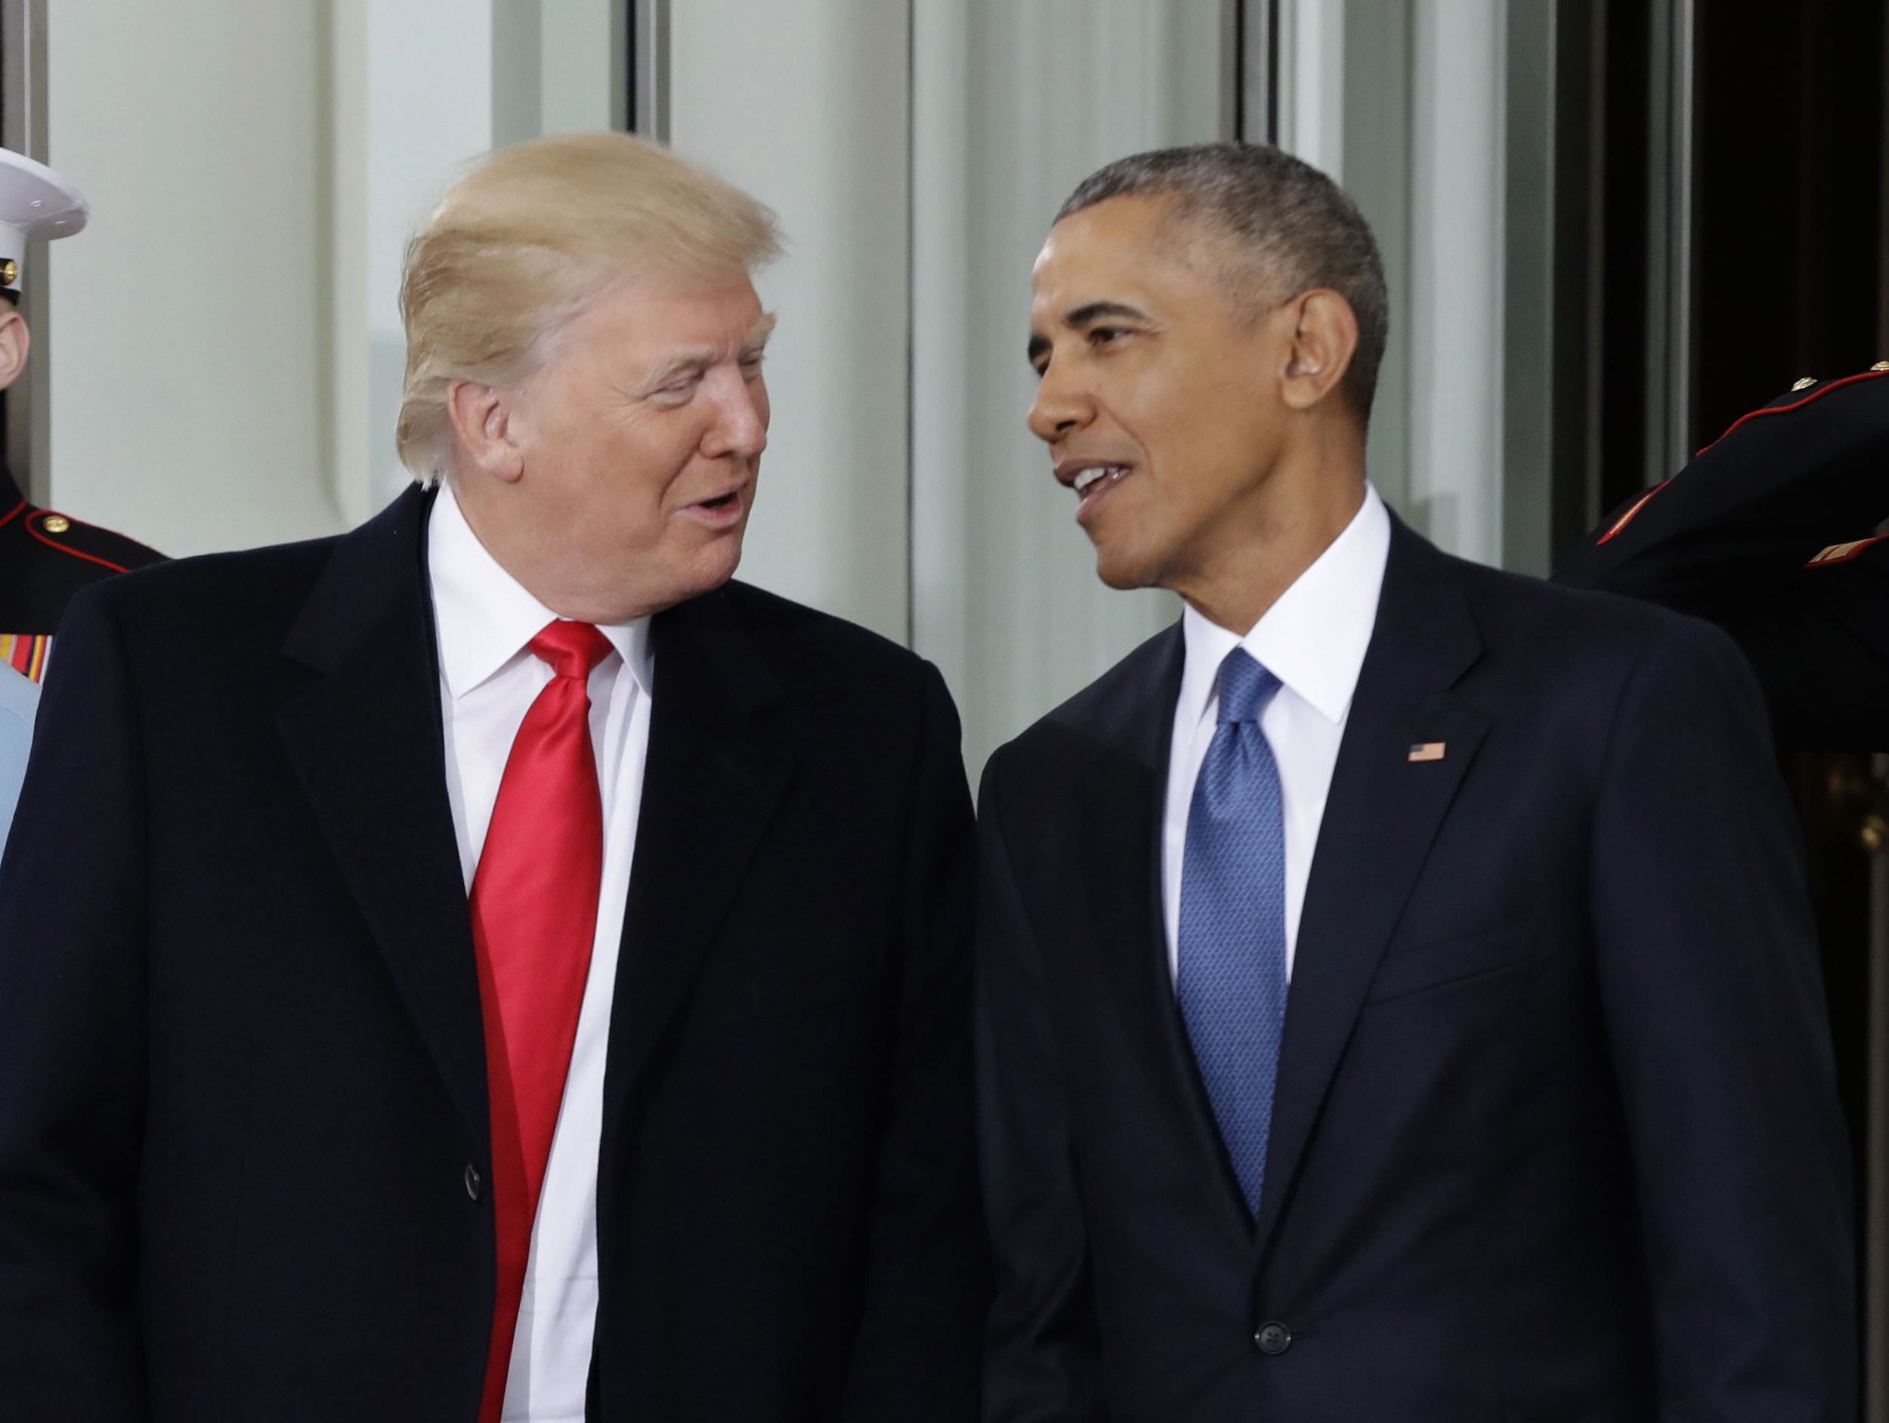
2. The insurrection

Slide 7
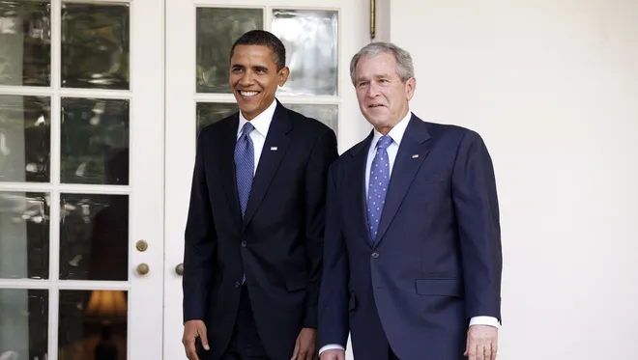
2. The insurrection

Slide 8
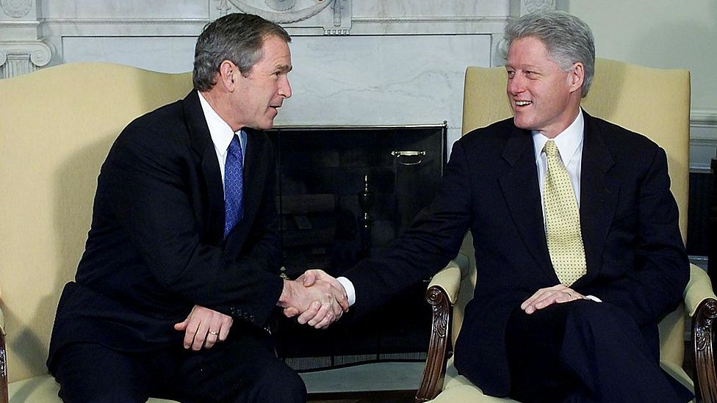
2. The insurrection

Slide 9
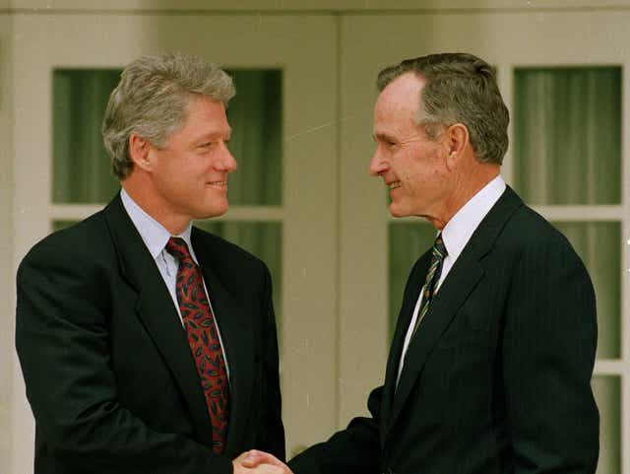
2. The insurrection

Slide 10
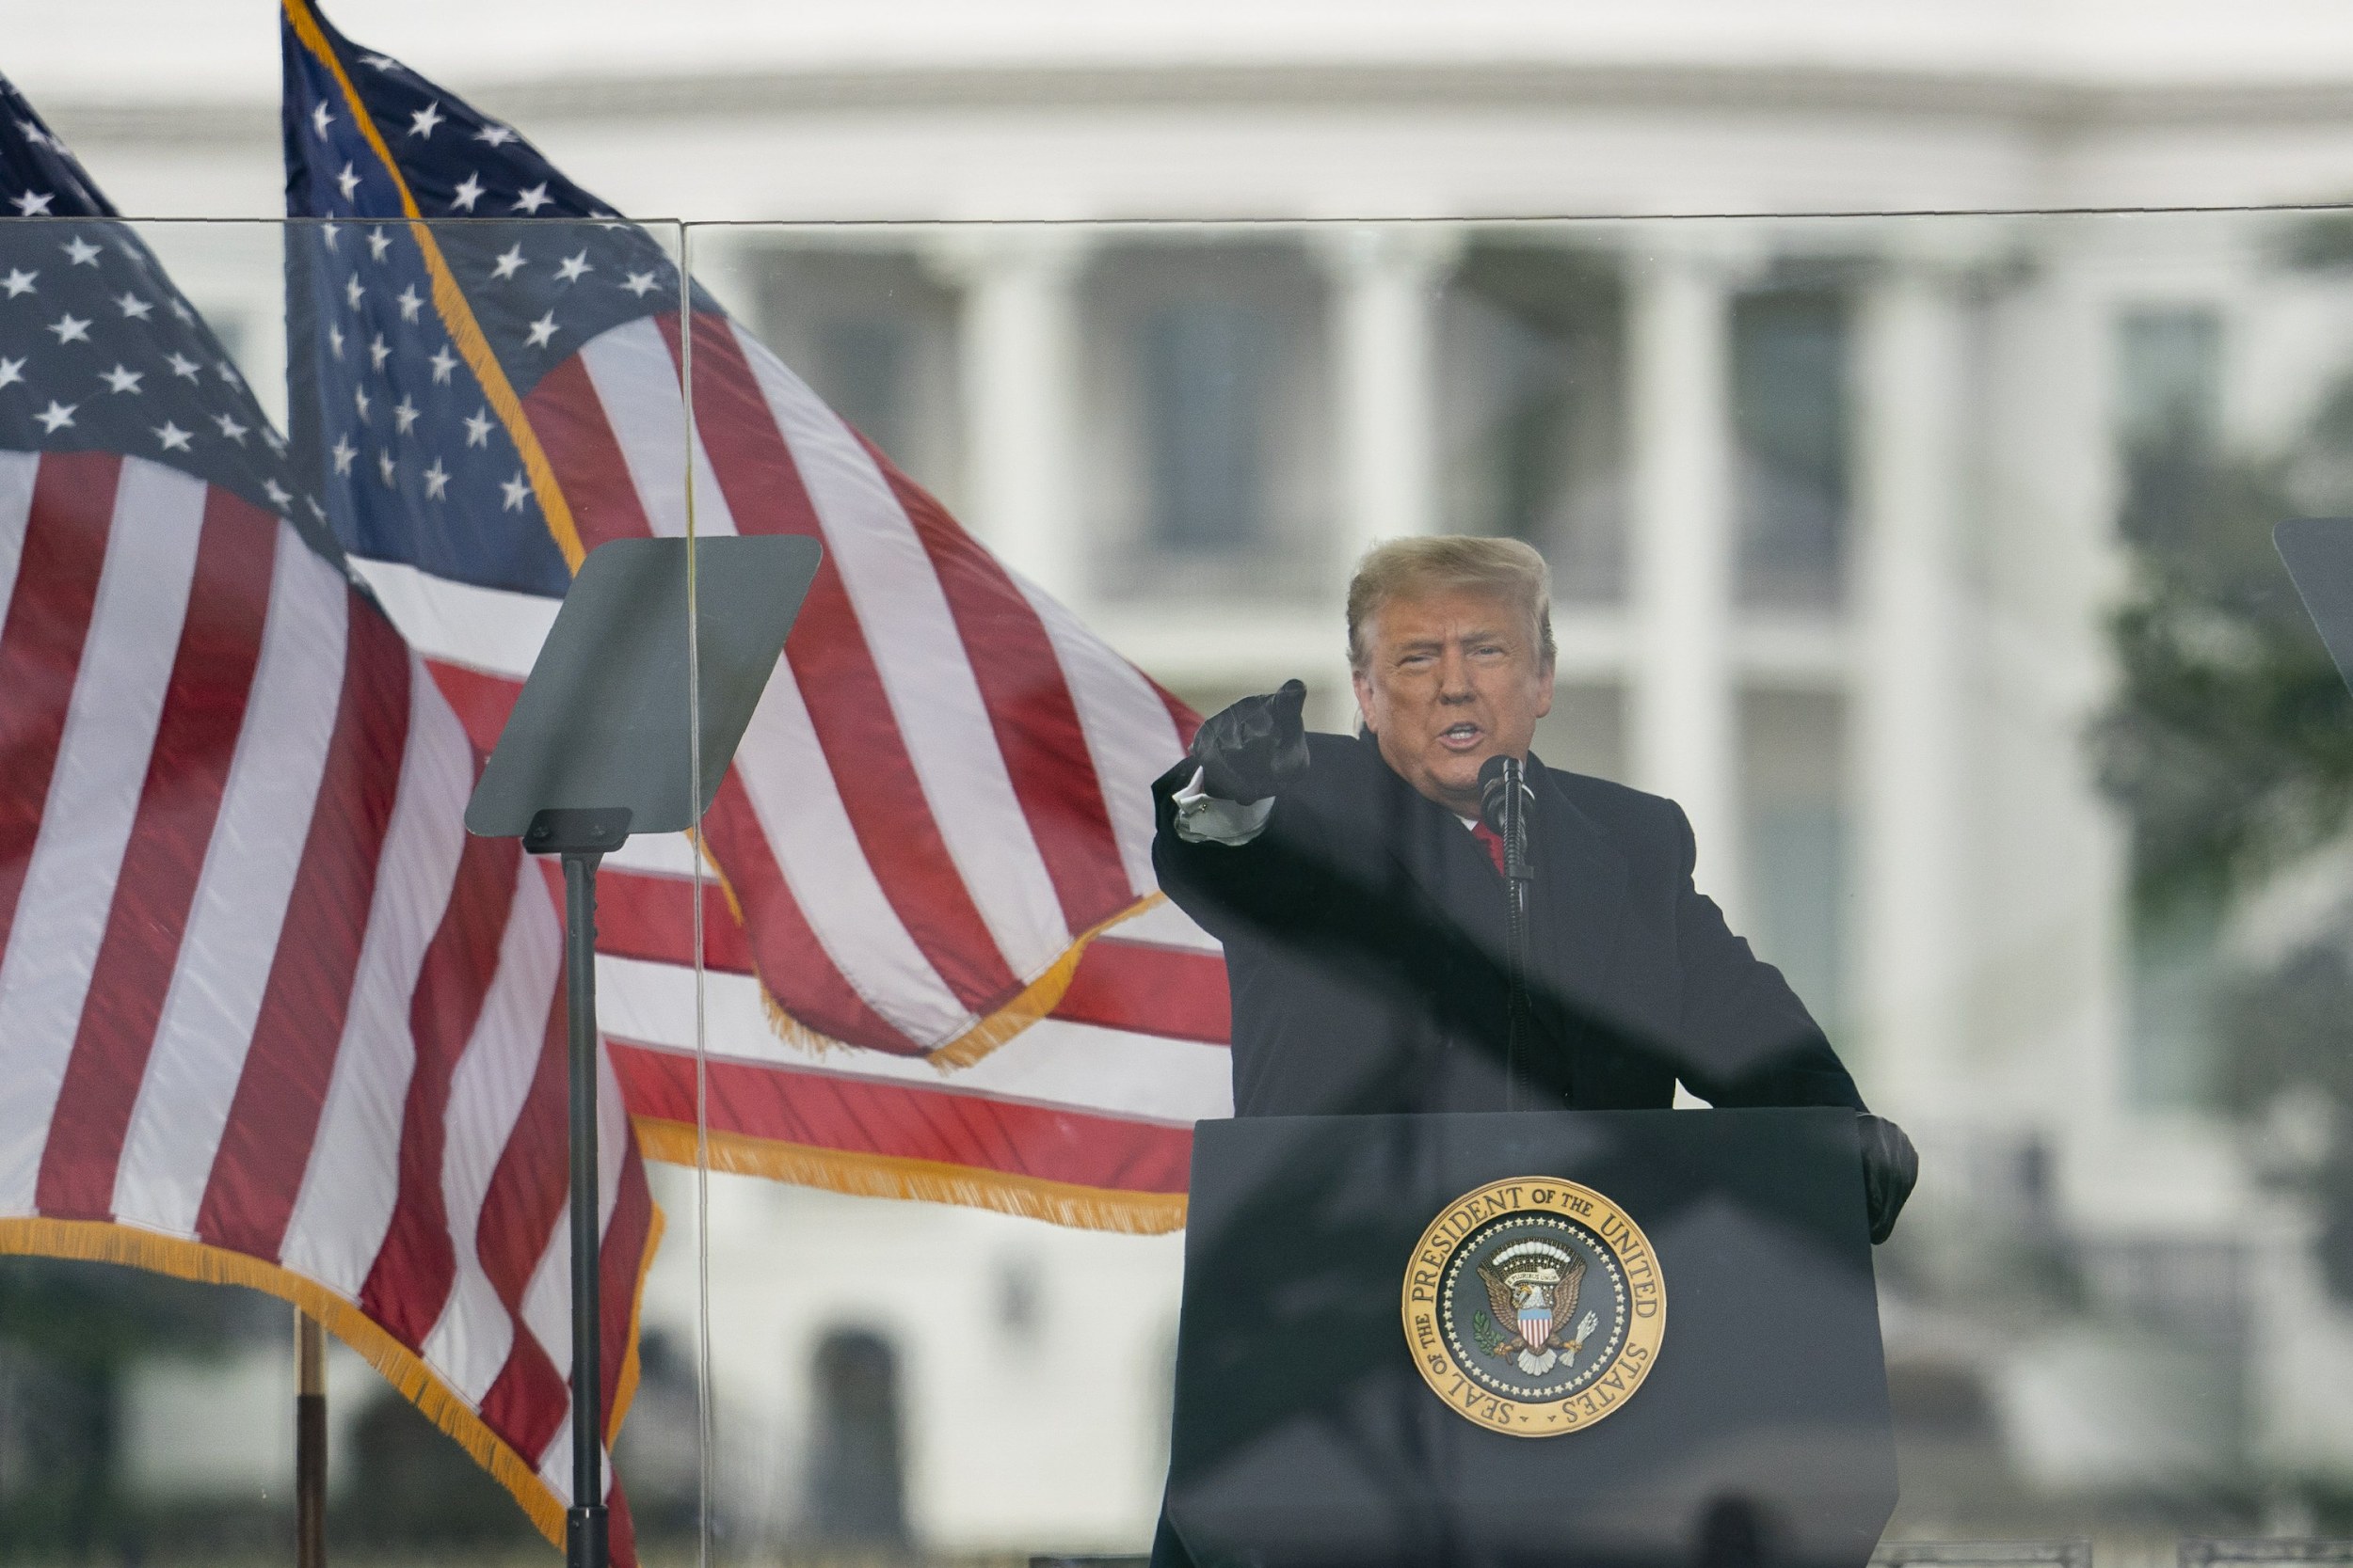
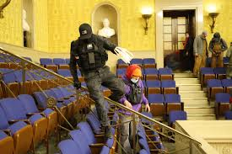
2. The insurrection
Prior to this year, every other presidential transition (except 1861) was peaceful and cooperative.
This one has not been.

Slide 11
2. The insurrection
Why was this year different?
Sometimes transitions are peaceful and cooperative, and sometimes they are not. Which kind of transition should surprise us?

Slide 12
2. The insurrection
Questions about politics:
Why do people accept these particular rules? Why do men with guns go along with democracy? Do the rules of elections even matter anyway?
Who made these election rules? Might they change? Might a dictator take over?
Does it even matter who wins?

Slide 13
Introduction and Overview
Hi!
Course Mechanics / Syllabus
The insurrection
Models
A first puzzle about governments

Slide 14
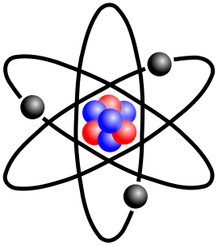
3. Models

Slide 15

3. Models

Slide 16
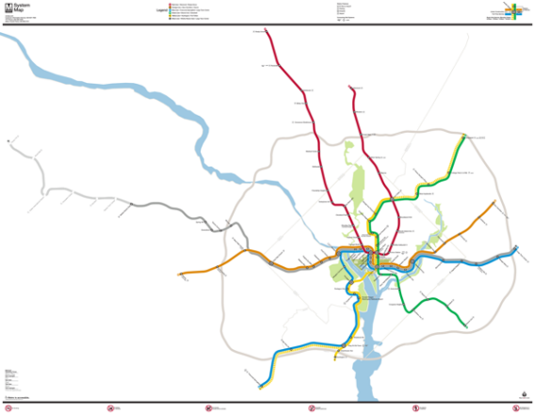
3. Models
B.1. Models

Slide 17
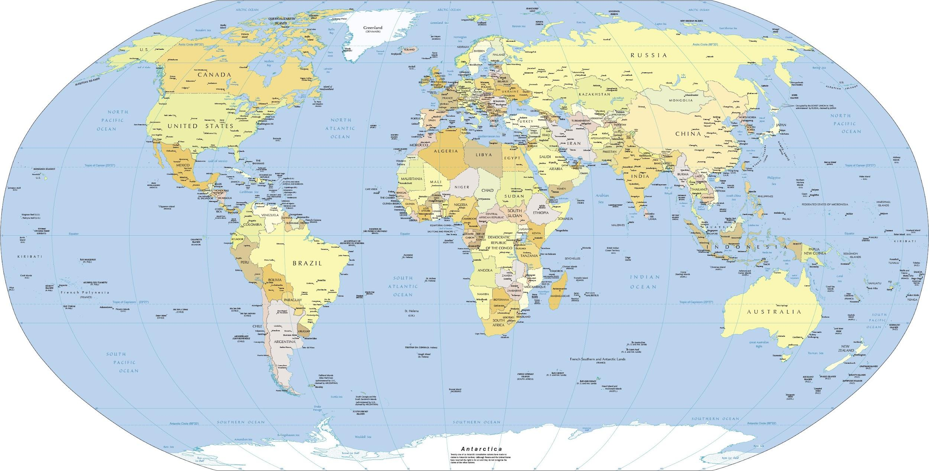
3. Models

Slide 18
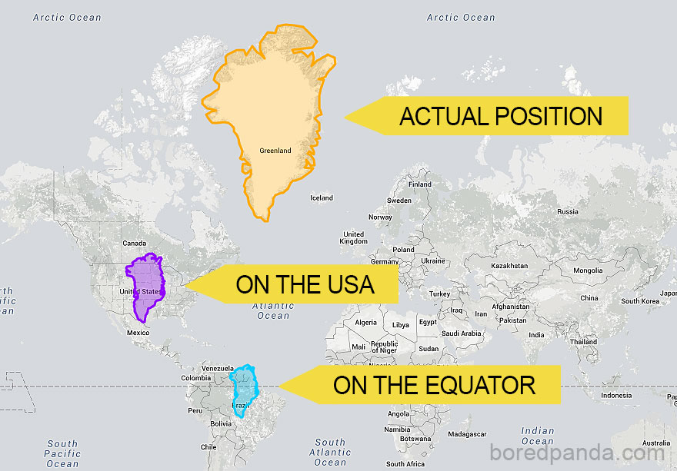
3. Models

Slide 19
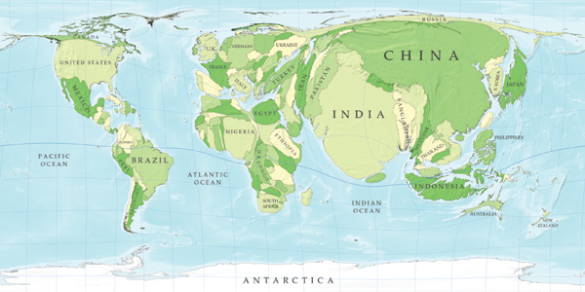
3. Models

Slide 20
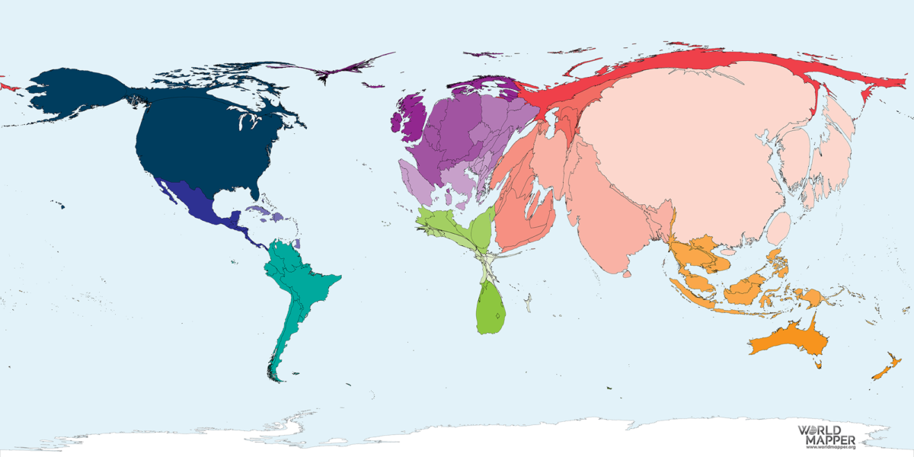
3. Models
Countries scaled by CO2 emissions

Slide 21
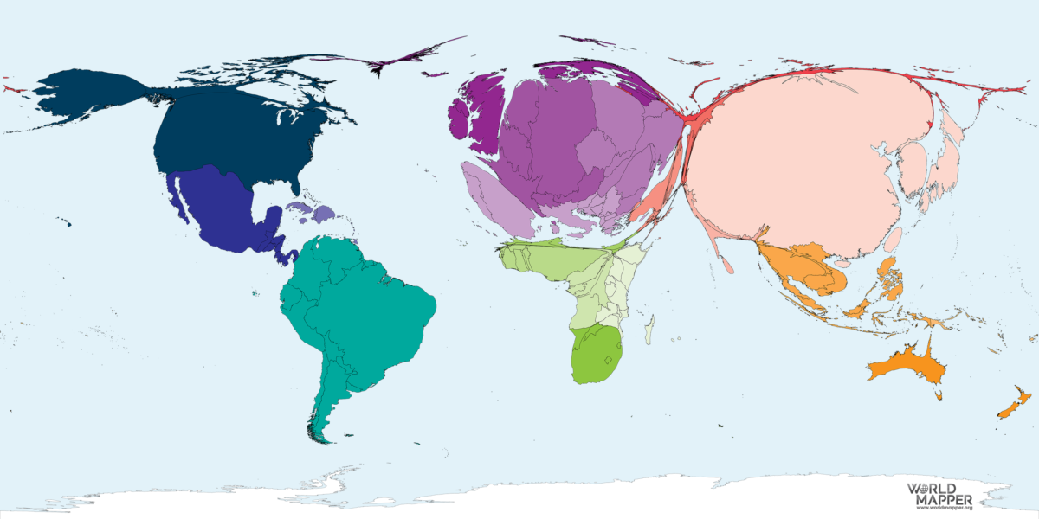
3. Models
Countries scaled by total beer production

Slide 22
3. Models
Models are lies, but they are useful lies
A model, like a map, is:
a simplified version of reality
that leaves out some details
in order to focus on something specific
to help us understand why things work they way they do

Slide 23
3. Models
Some models we’ll be using:
Delegation
Coalition
Representation
Social movement
Social identity
Revolution
and lots of others

Slide 24
Introduction and Overview
Course Mechanics
The insurrection
Models
A first puzzle about governments

Slide 25
4. A first puzzle about governments
Rulers are people who enforce rules. So, rulers need to be strong enough to make people follow the rules.
But any rulers strong enough to make people follow their rules are also strong enough to break rules that constrain them.
So, when and how do “rules about rulers” ever matter?

Slide 26
4. A first puzzle about governments
Part 1 of the course is about who rules
To whom are rulers accountable?
How are they held accountable?
Why does it matter?
Two broad systems:
Democracy - rulers are accountable to many people
Autocracy - rulers are accountable to fewer people

Slide 27
Next class: September 3
Reading: Textbook Chapter 1
The Democracy Doomsayers Consider 2020 (New York Times, 2019)

